Slide 1
확률 이론
스마트자동차학과
박성근(keiny@sch.ac.kr)

Slide 2
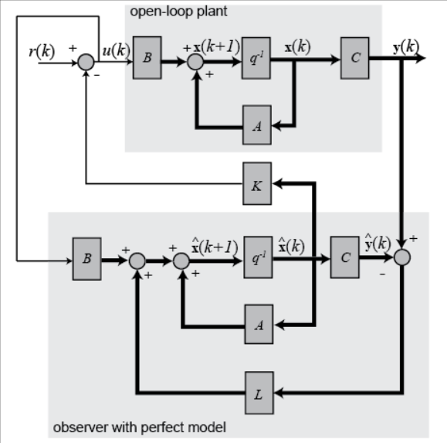
Why Estimator?

Slide 3
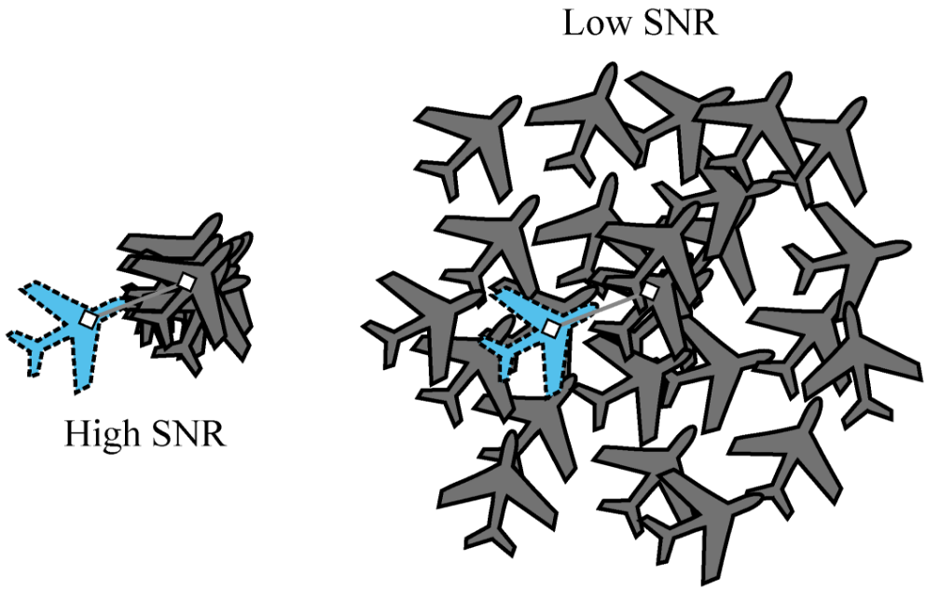
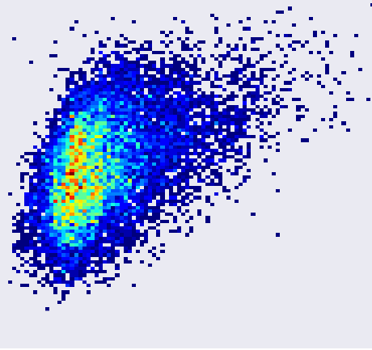
Why Probabilistic?
■ Stochastic Observer
Since we do not know the exact value of measurement noise, we have to estimate the real state probabilistically.
Noise has its probabilistic distribution
↔ Deterministic

Slide 4
Basic Probability Theory
Random variable
Specific event that might be taken

Slide 5
Basic Probability Theory
Gaussian Distribution

Slide 6
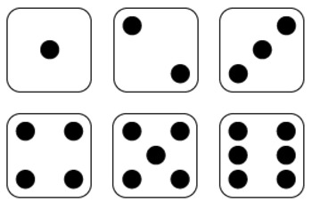
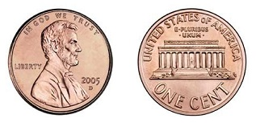
Basic Probability Theory
Joint distribution of two random variables and
Dice : 1,2,3,4,5,6
Coin : Head/Tail

Slide 7
Basic Probability Theory
Conditional Probability of two random variables and
Dice : 1,2,3,4,5,6
Coin : Head/Tail

Slide 8
Basic Probability Theory
If two random variables and are independent, then
①
②

Slide 9
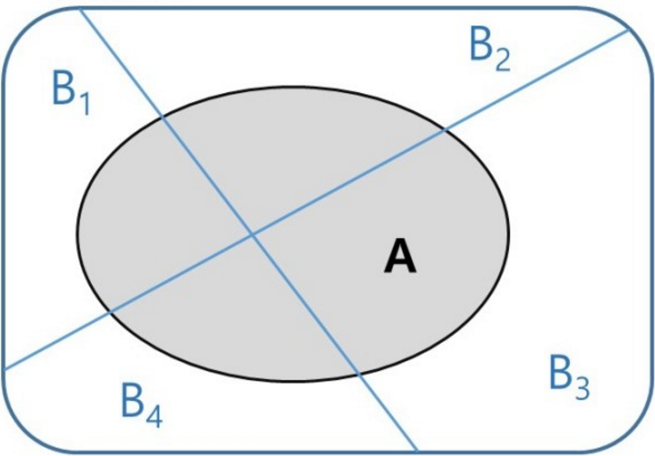
Basic Probability Theory
Total Probability Theorem

Slide 10
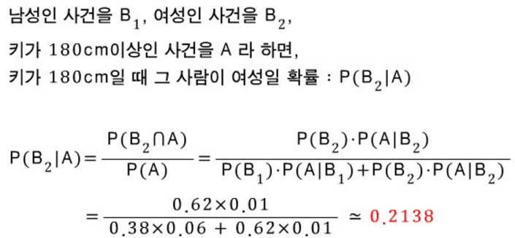
Basic Probability Theory
어느 도시의 남성의 6%, 여성의 1%의 키가 180cm 이상이다. 그리고 여성은 도시 인구의 62%를 차지한다. 임의로 한 사람을 선택했더니, 키가 180cm 이상일 때, 그 사람이 여성일 확률은?

Slide 11
Basic Probability Theory
Bayes Rule : Generative Model
Naive Bayesian Classifier, Bayes filter, Bayesian Network,
Bayesian Estimator….

Slide 12
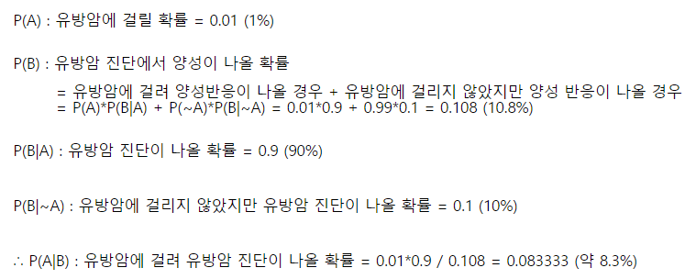
Basic Probability Theory
암 판정은 확률상 오진이 많기 때문에 많은 검토가 요구된다. 일반적인 성인 여성이 유방암에 걸릴 확률이 1%이고, 건강 검진 검사 정확도가 90%일때, 한 여성이 검강검진 결과 암 판정을 받았다. 진짜로 암에 걸렸을 확률은?

Slide 13


Bayes Rule
Car == G70?
Car == G70
Image
Image

Slide 14
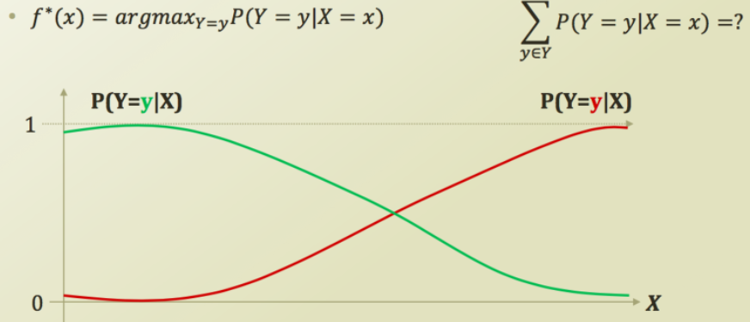
Basic Probability Theory
Naïve Bayes classifier

Slide 15
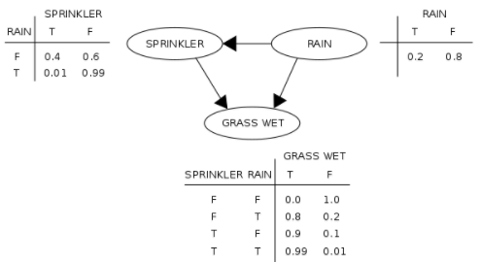
Basic Probability Theory
Bayesian Network with Bayesian Inference

Slide 16
Basic Probability Theory
Extension of Conditional Probability
Random variables and are conditional independence, if
Conditional independence is not equal to absolute independence

Slide 17


Environment Interaction
■ State?
Some parameters what we want to control or estimate and so on…
For example…
Longitudinal distance
Longitudinal velocity
Longitudinal acceleration
Lateral distance
Lateral velocity
Lateral acceleration

Slide 18
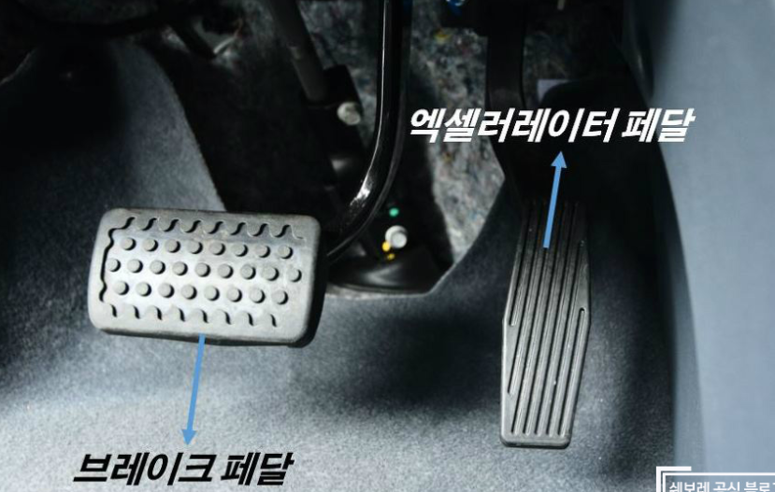
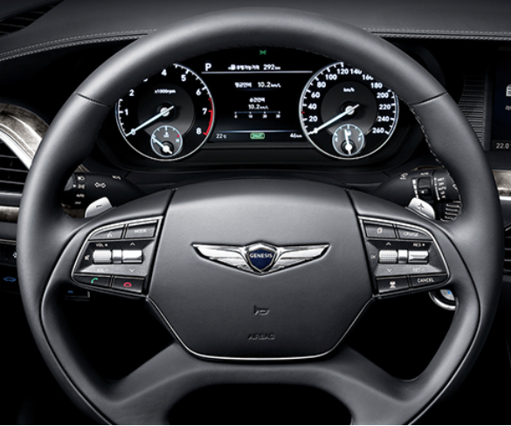
Environment Interaction
■ Control Input?
Make target move
For example…

Slide 19
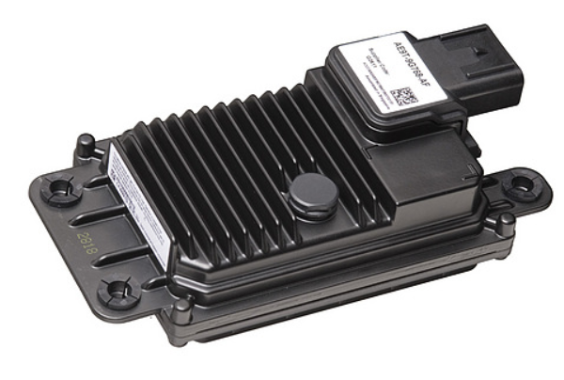
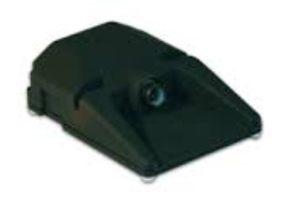
Environment Interaction
■ Measurement?
Know target move
For example…

Slide 20
Environment Interaction
■ Noise?

Slide 21
Environment Interaction

Slide 22
Probabilistic Generative Laws
Localization Problem is
- recognize own vehicle’s kinematic information using inaccurate measurement and its control input
- recover own vehicle’s kinematics information using insufficient measurement
- find own vehicle’s kinematics information recursively
Definition of belief

Slide 23
Probabilistic Generative Laws
Tracking Problem is
- recognize object kinematics information using inaccurate measurement
- recover object kinematics information using insufficient measurement
- find object kinematics information recursively
Definition of belief

Slide 24
In this course…
Bayes filter : Start of this course
Kalman filter : 1 to 1 filter in linear/Gaussian Case
Extended Kalman fulter : 1 to 1 filter in non-linear/Gaussian case
Unscented Kalman filter : 1 to 1 filter in non-linear/Gaussian case
Interacting Multiple Model : 1 to 1 filter using parallel filter combination
Particle filter : 1 to 1 filter in non-linear/non-Gaussian case
Probabilistic Data Association filter : n to 1 filter in Gaussian case
Joint Probabilistic Data Association filter : n to n filter in linear/Gaussian case
Multiple Hypothesis Tracking : n to n filter in linear/Gaussian case

